Slide 1
“Tail division” (long division) V2
by Hurles

Slide 2


Slide 3
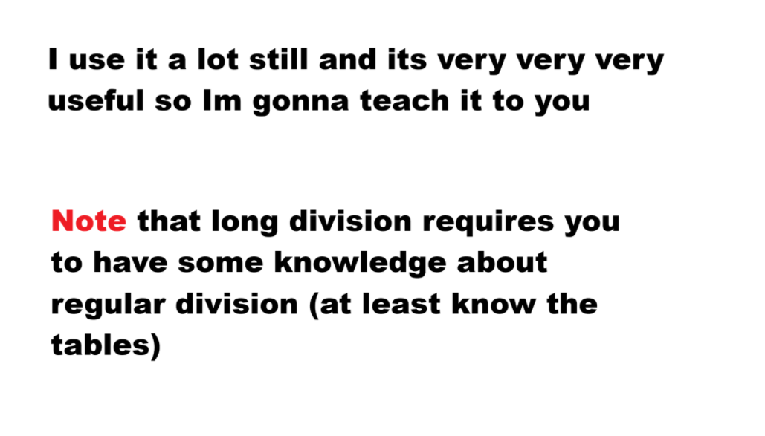

Slide 4
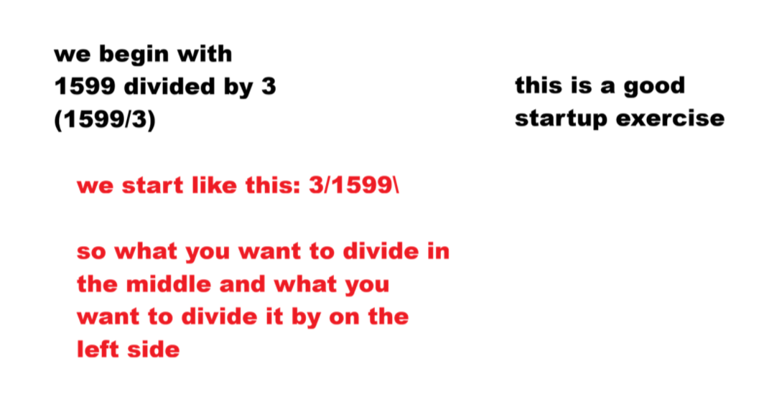

Slide 5
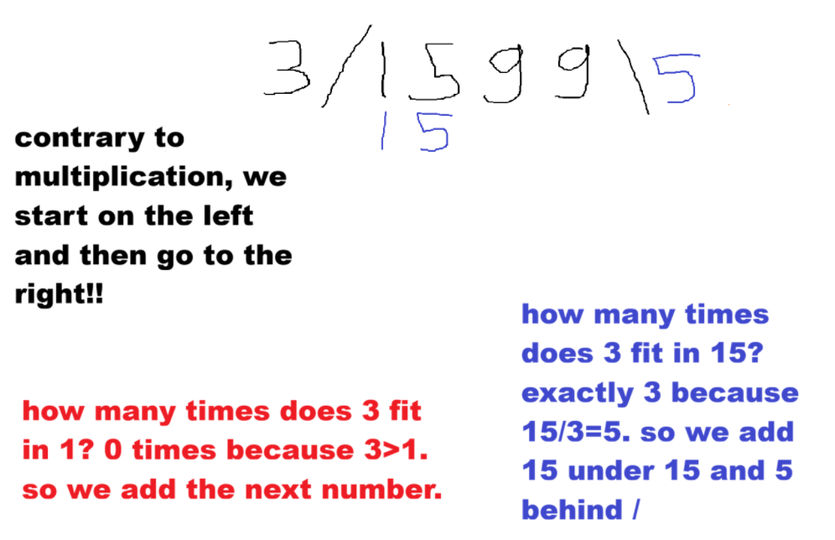

Slide 6
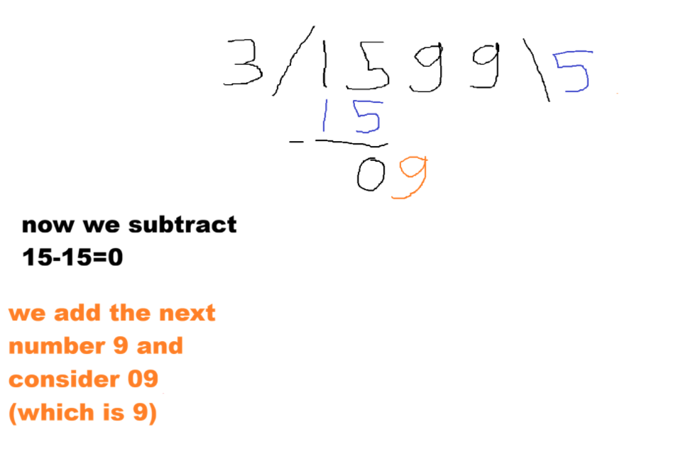

Slide 7
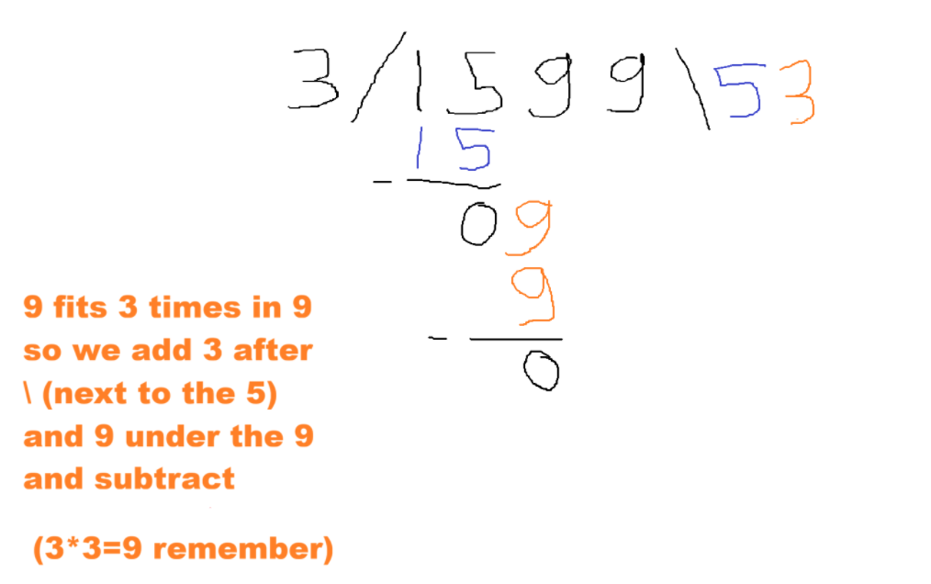

Slide 8
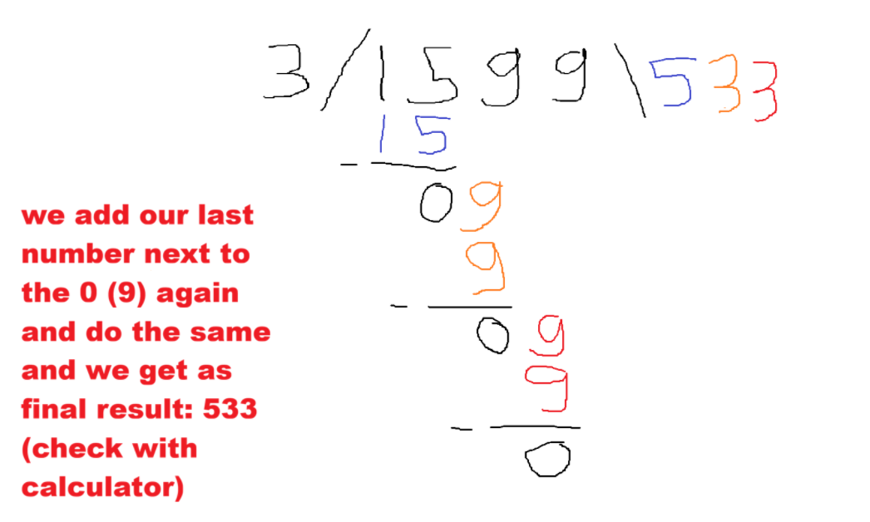

Slide 9
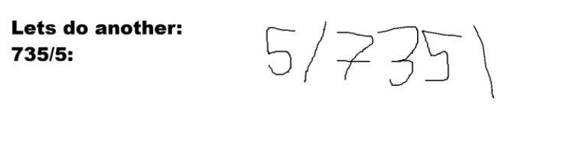

Slide 10
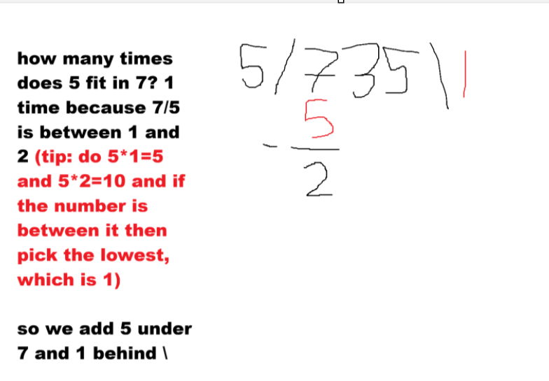

Slide 11
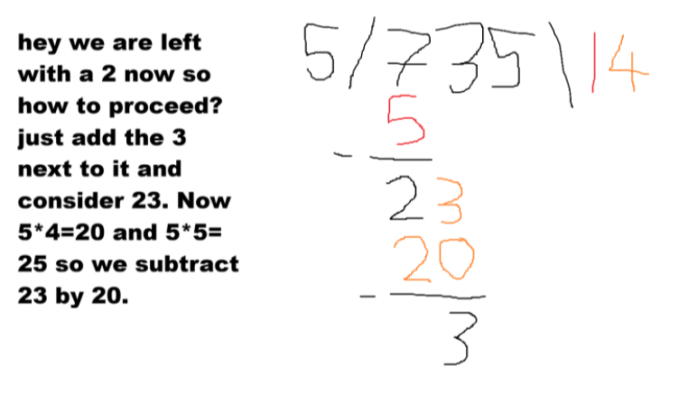

Slide 12
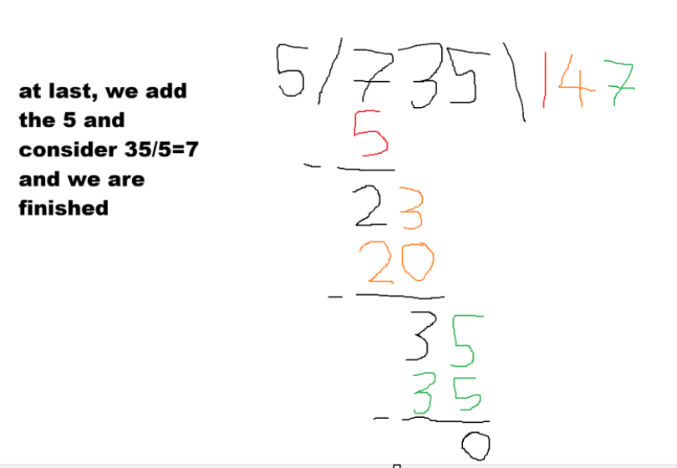

Slide 13
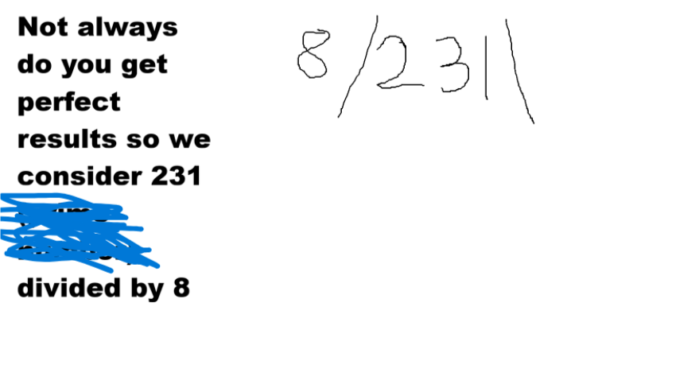

Slide 14
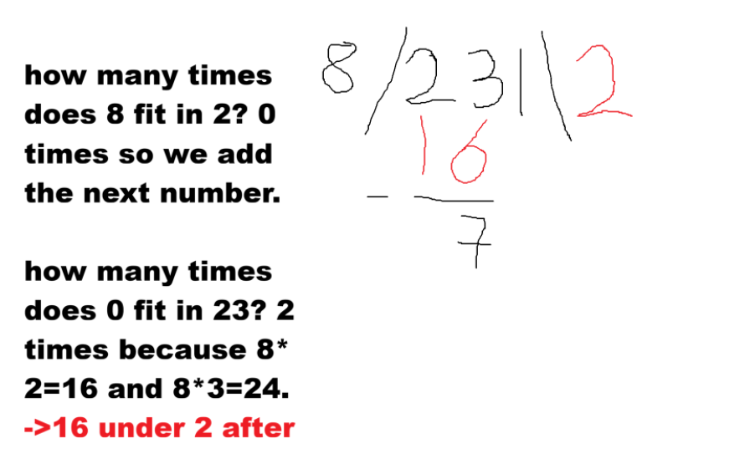

Slide 15
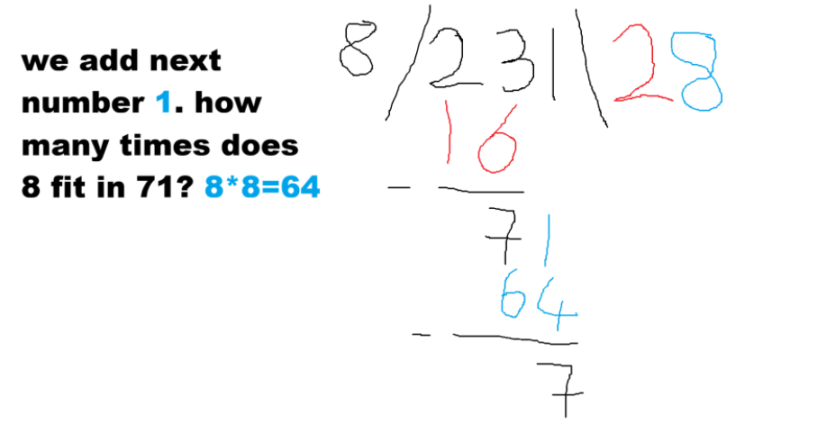

Slide 16
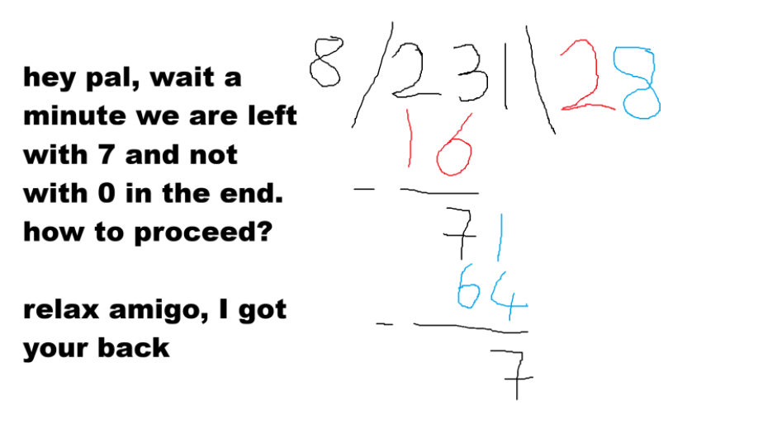

Slide 17
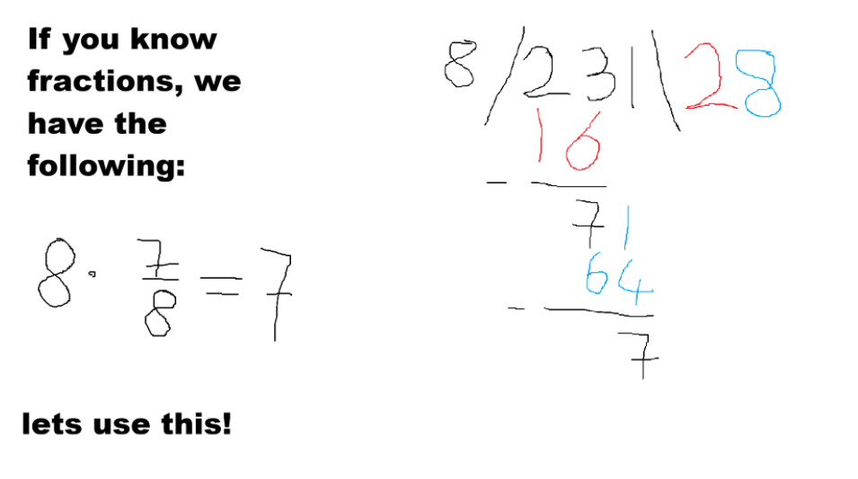

Slide 18
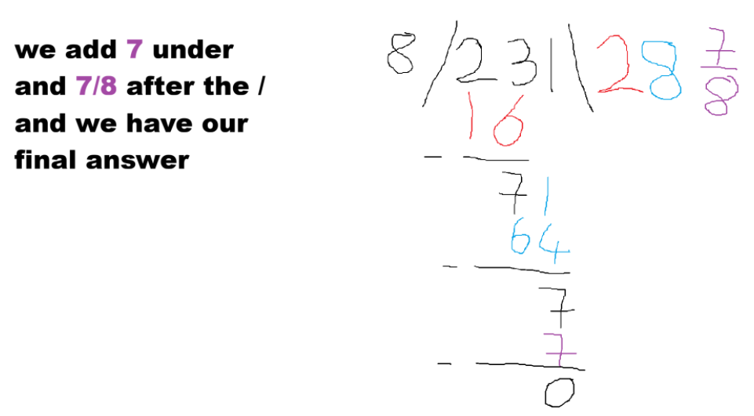

Slide 19
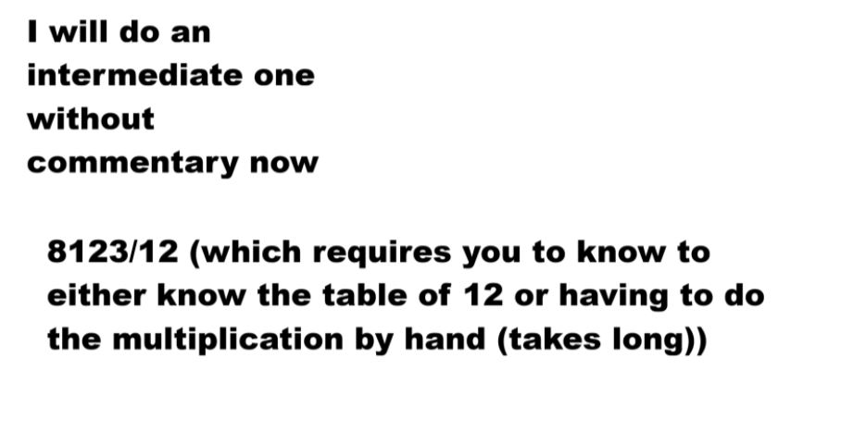

Slide 20
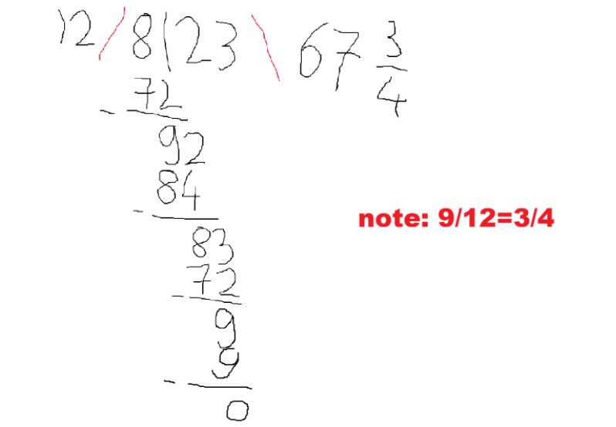

Slide 21
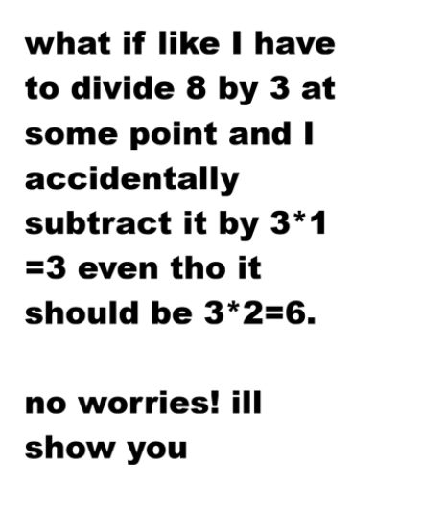

Slide 22
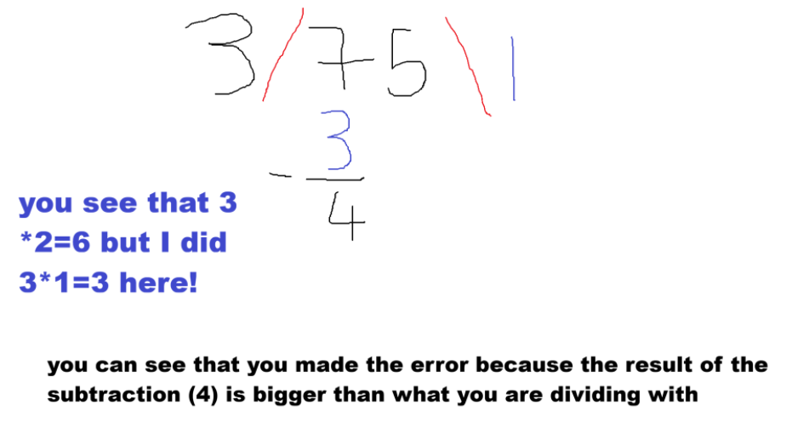

Slide 23
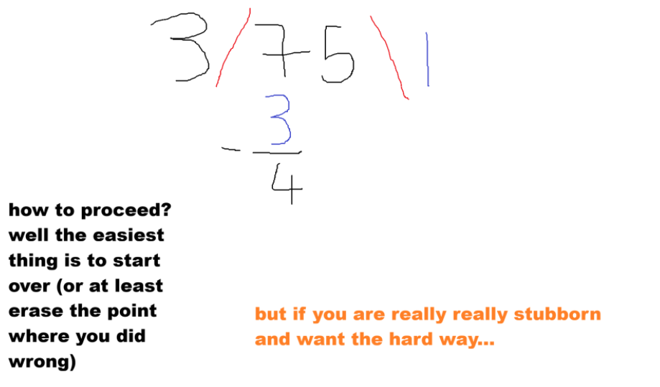

Slide 24
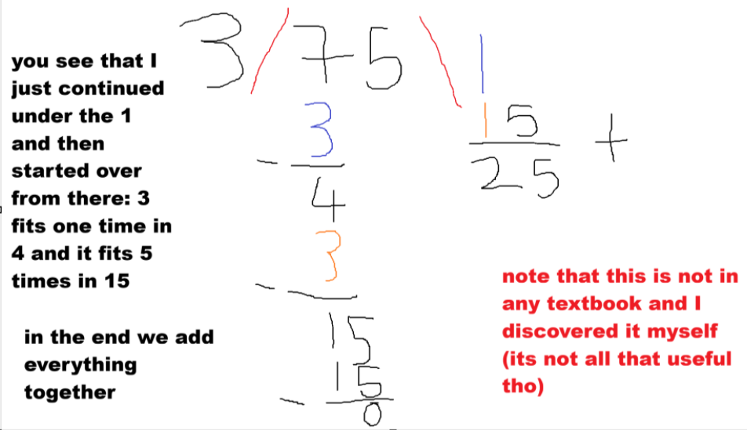

Slide 25
Revision!!
There seemed to have been a gap in this tail division method caused by the number 0 (if the final answer has a 0 in it somewhere like 3000/10 = 300 which has two zeros in the final answer)

Slide 26

THERE IS A FIX THO :D
It is quite complicated but basically if a number is added from number x in the /x\ section (what you are tail dividing), then if the number is smaller than divisor (like youre dividing by 3 and 1 is smaller than 3) then add 0. BUT if the number after having added every number from the /x\ section and like a number remains (like 31/10 and 1 remains after subtracting 30) then introduce a fraction! I will demonstrate it by two examples and hope its somewhat clear

Slide 27
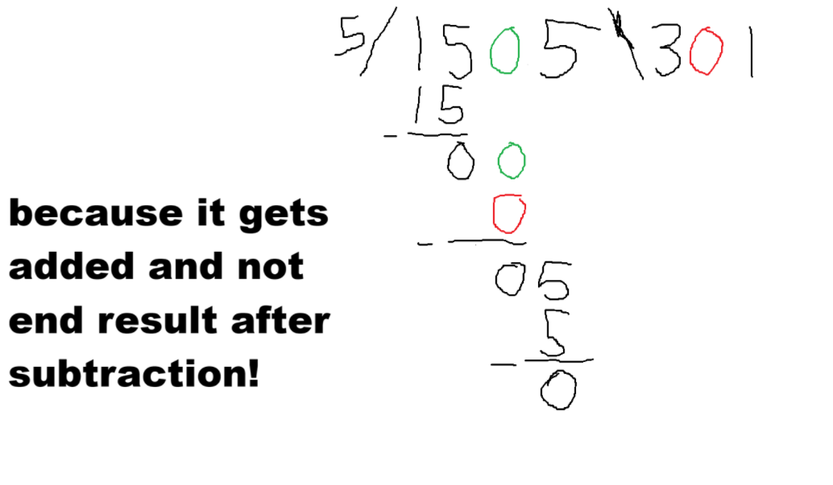

Slide 28
